Slide 1
DM561 – Linear Algebra with Applications Week 49, 2021 Principal Component Analysis and Eigenfaces
Daniel Merkle
daniel@imada.sdu.dk

Slide 2
Introduction and Motivational Example
PCA is considered the “the mother of all methods in multivariate data analysis”
Dimensionality reduction
Exploit linear dependencies in data
PCA can be seen as a method to compute a new coordinate system formed by latent* variables, which is orthogonal, and where only the most informative dimensions are used.
Dimension reduction by PCA is mainly used for
Visualization of multivariate data
Transformation of highly correlating variables into a smaller set of uncorrelated
Separation of relevant information from noise
Combination of several variables that characterize a chemical-technological process
*variables that are not directly observed but are rather inferred (through a mathematical model)

Slide 3
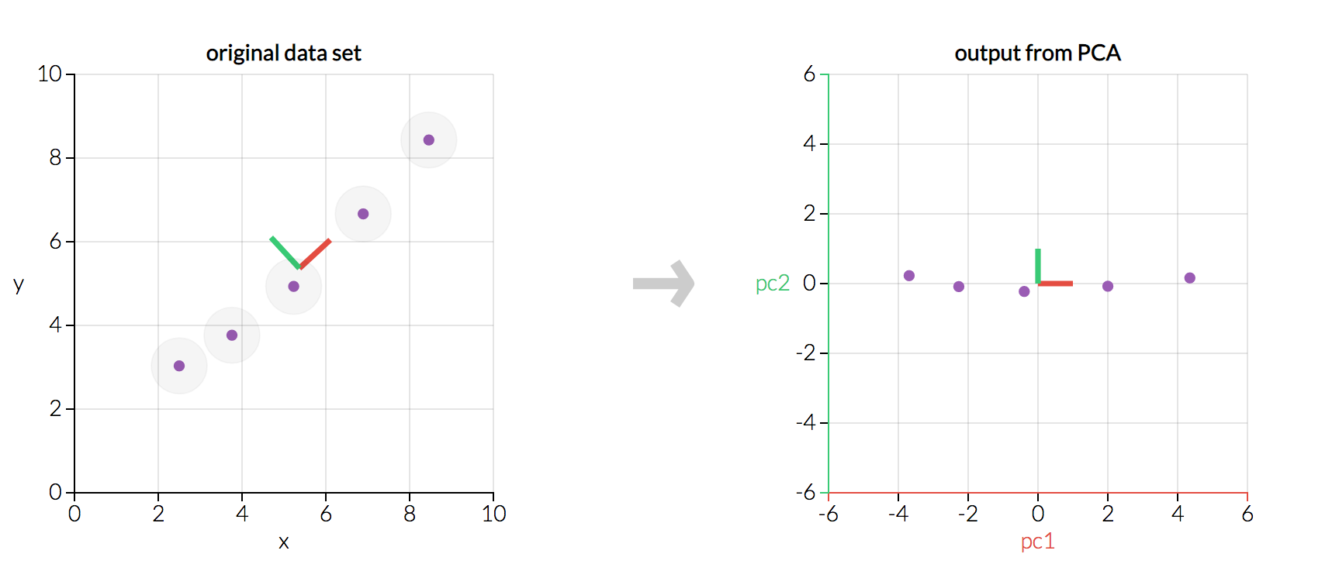
PCA finds a new coordinate system
Nice visualization : http://setosa.io/ev/principal-component-analysis/

Slide 4
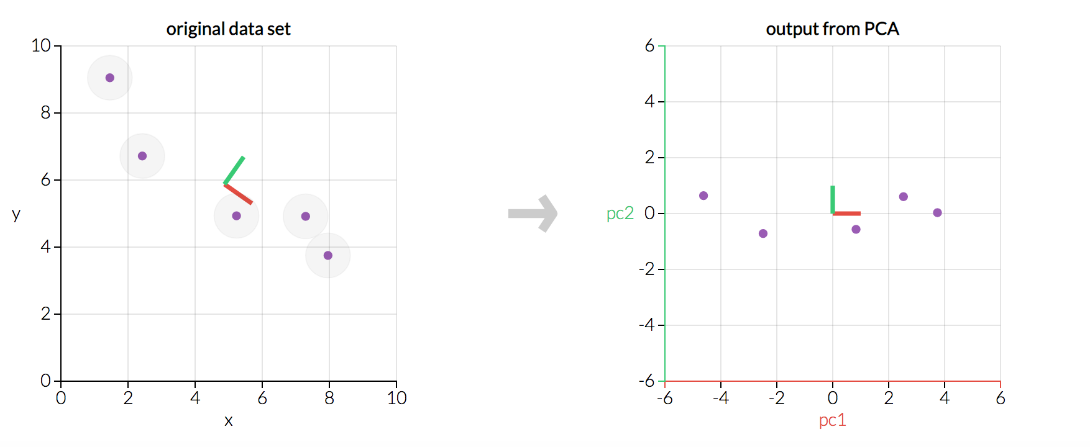
New Dimensions are called Principal Components
This transformation is defined in such a way that the first principal component has the largest possible variance (that is, accounts for as much of the variability in the data as possible), and each succeeding component in turn has the highest variance possible under the constraint that it is orthogonal to the preceding components.

Slide 5
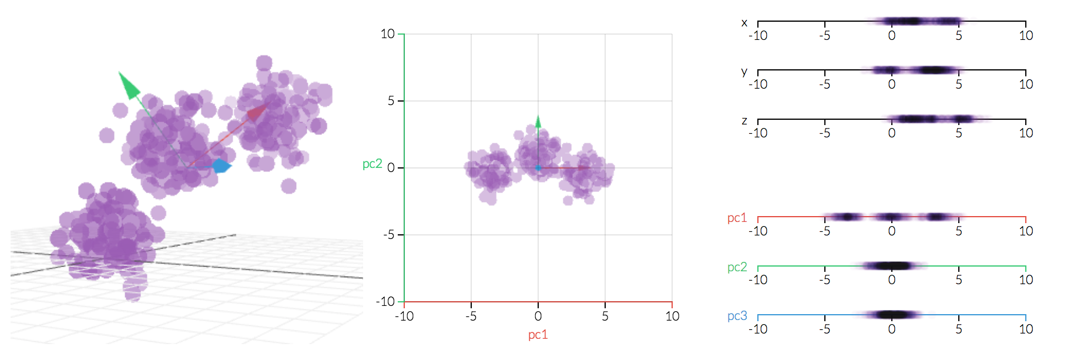
Dimensionality Reduction
Original (observed) data Projected data

Slide 6
Mathematical Background
Orthogonal Basis
Linear Transformation
Covariance Matrix
And (we will use without proof):
The inverse of an orthonormal matrix is its transpose (1)
For any matrix A, A^{T}A and AA^{T} are symmetric.
A matrix is symmetric if and only if it is orthogonally diagonalizable.
A symmetric matrix is diagonalized by a matrix of its orthonormal eigenvectors, i.e., for any squared symmetric matrix A, there exists a diagonal matrix D, such that A = E D E^{T} ,where the i-th column of E is the i-th eigenvector of E (special case of an SVD decomposition). The orthonormal column vectors of E span a space, and due to (1) E⁻¹ = E^{T}

Slide 7
Change of Basis – Linear Transformation
[ Presented on (virtual) blackboard. More details : page 3 of A Tutorial on Principal Component Analysis (Jonathon Shlens) ]
Original data: X (m x n matrix) P is the matrix that transforms X into Y Y (m x n matrix) is the new representation of the data set The rows of P are the new basis vectors
Later, m will be the number of features/dimensions, n will be the number of samples

Slide 8
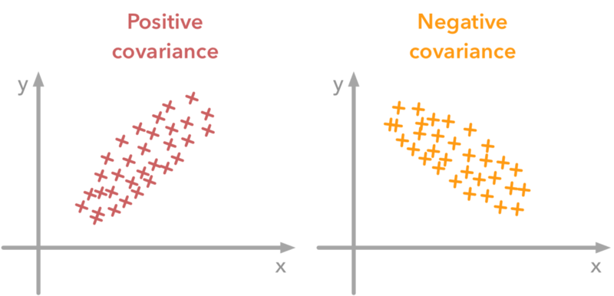
Mathematical Prerequisites - Covariance
Assuming A and B are mean centered:
Assuming (mean-centered) row vectors for a and b:
[ Bessel’s correction: n-1 in the denominator, see https://en.wikipedia.org/wiki/Bessel%27s_correction ]

Slide 9
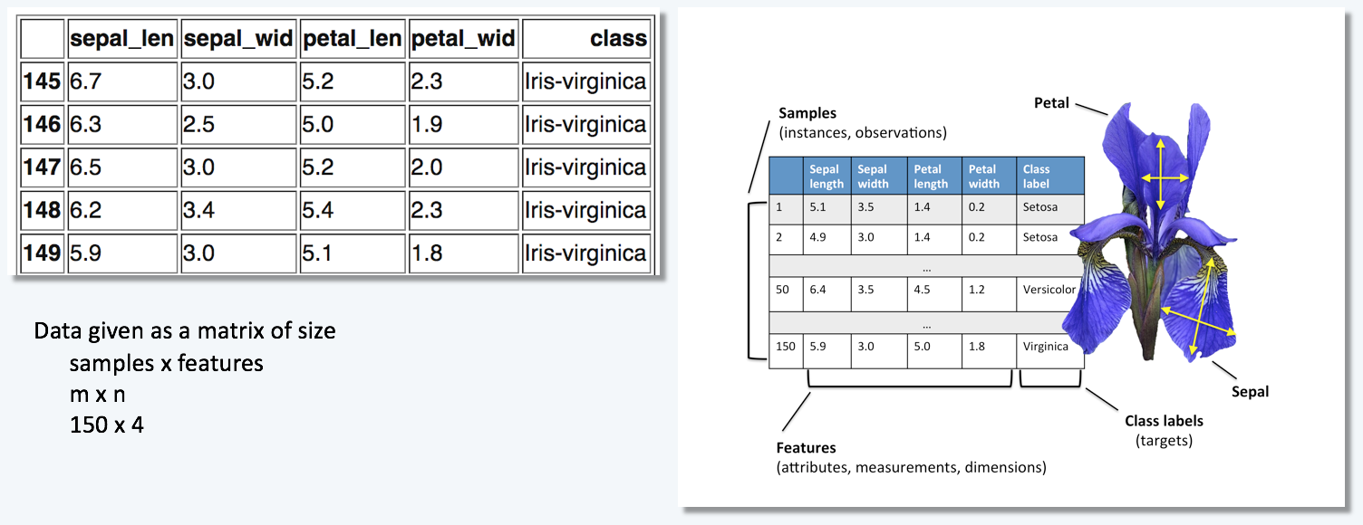
Covariance Matrix
A note of caution, sometimes the role of column and row (type of measurement/samples) is switched. Obviously, then:
Assume data (m types of measurements) given as
Each row of X corresponds to all m measurements of a particular type. Each column of X corresponds to a set of all n measurements from one particular trial.
Covariance Matrix :
captures the covariance between all possible pairs of measurements. The covariance values reflect the noise and redundancy in our measurements.

Slide 10
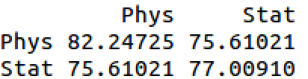
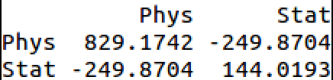
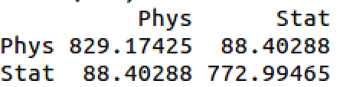
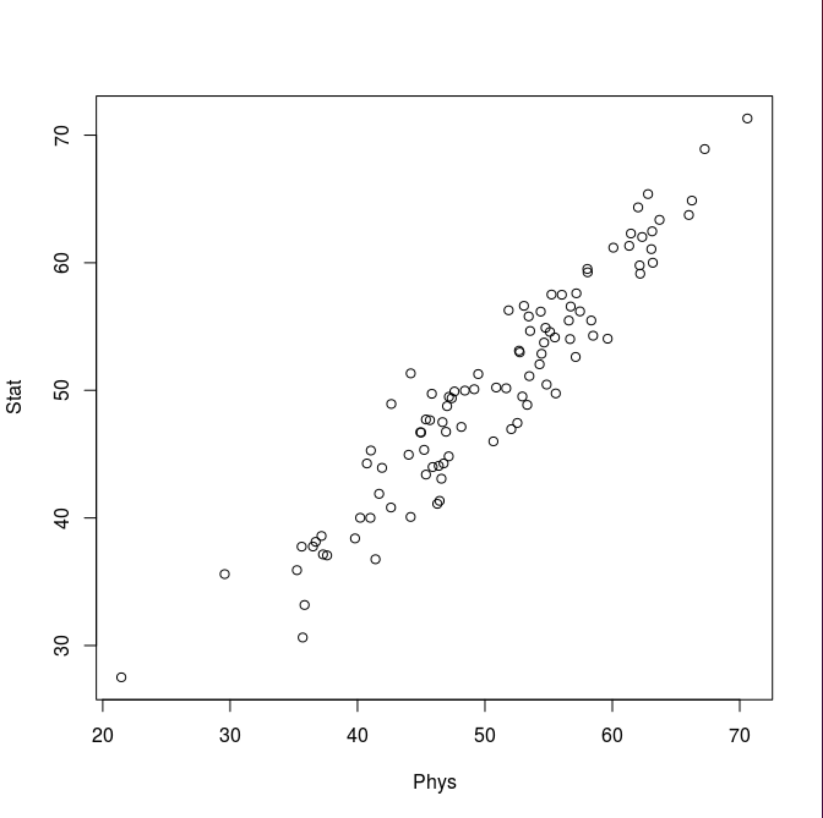
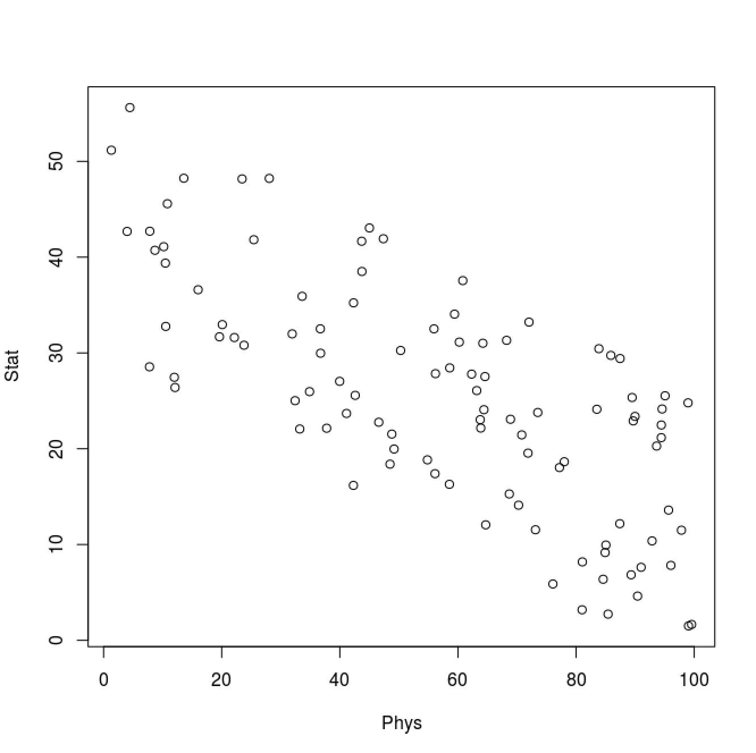
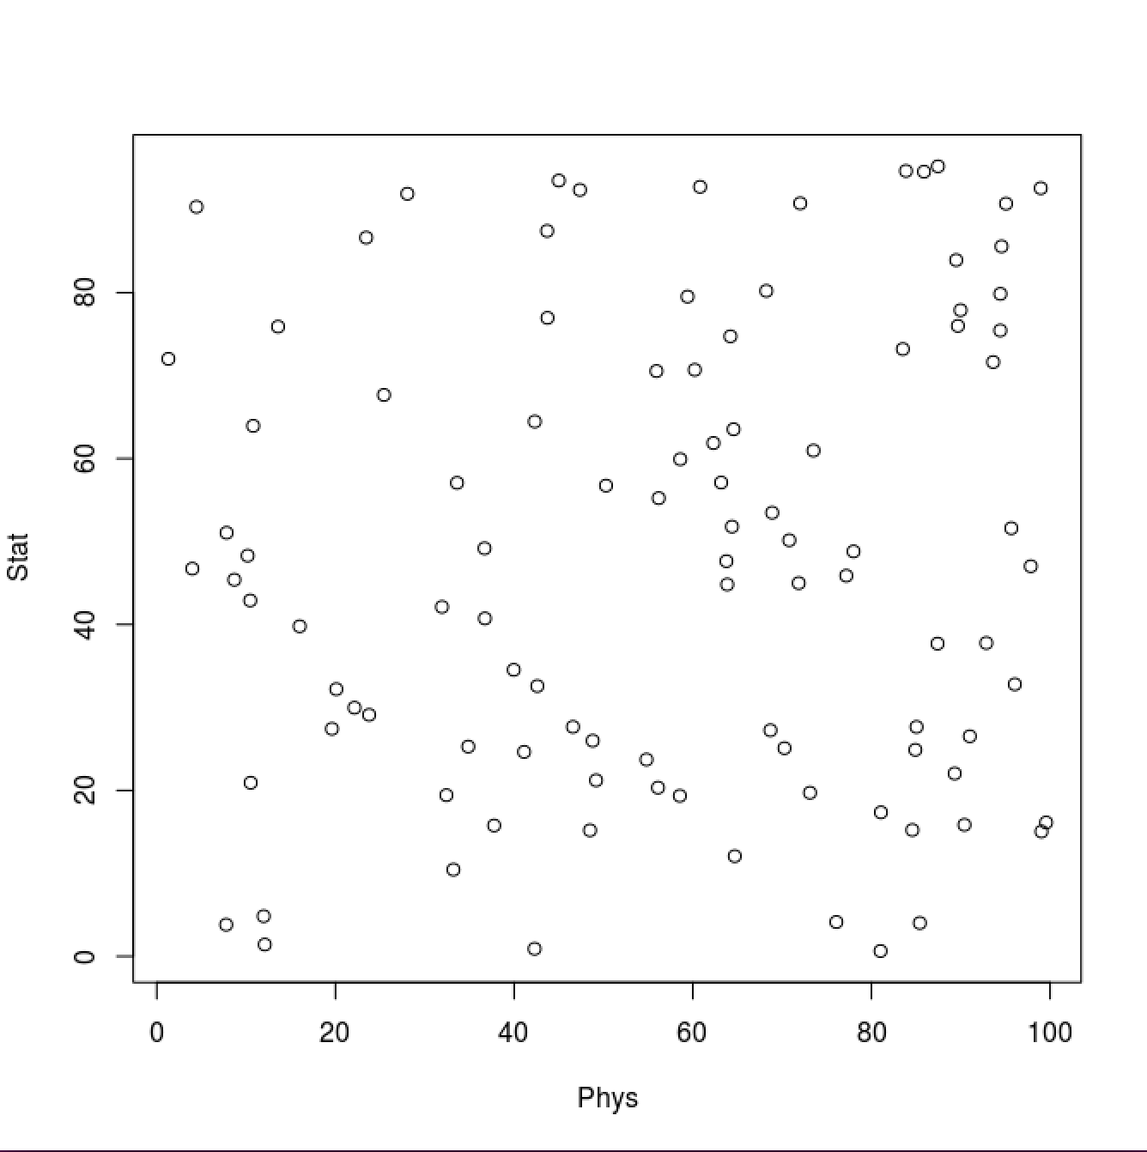
Properties of the Covariance Matrix
C_{X} is a square symmetric m × m matrix (m is the number of features)
The diagonal terms of C_{X} are the variance of particular measurement types.
The off-diagonal terms of C_{X} are the covariance between measurement types.
Example: Physics and Statistics grade [0-100 points], measured for 100 students

Slide 11
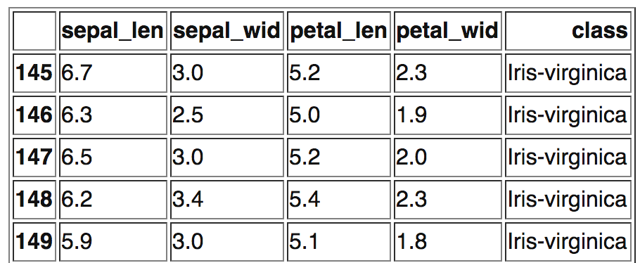
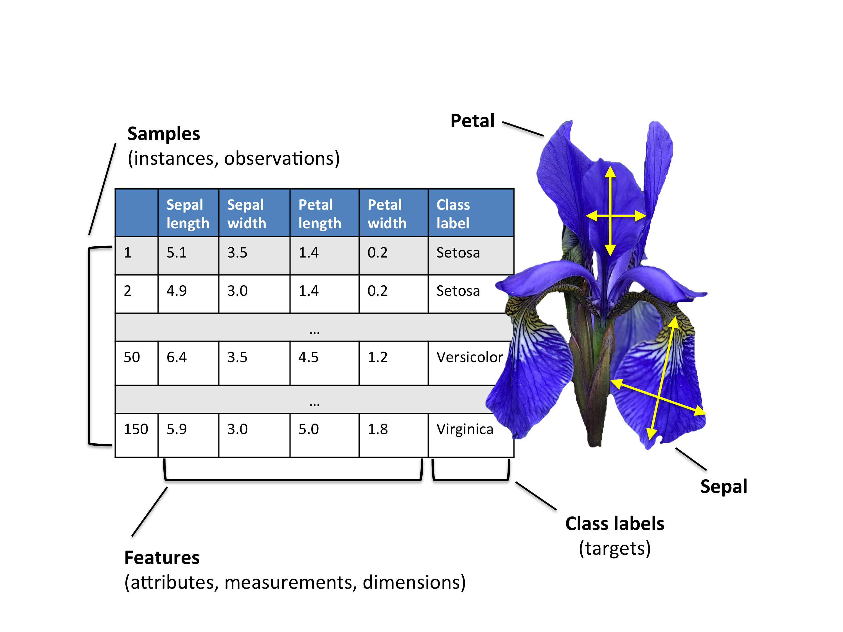
Iris Example (150 samples, 50 from 3 different species) https://en.wikipedia.org/wiki/Iris_flower_data_set
Data given as a matrix of size samples x features n x m 150 x 4

Slide 12
Question!
Pretend we have the option of manipulating the covariance matrix C_{X} (by a change of basis such that X will be transformed into Y, i.e., Y = PX). We will define our manipulated covariance matrix C_{Y}. What features do we ideally want to have in C_{Y}?
All off-diagonal terms in C_{Y} should be zero. Thus, C_{Y} must be a diagonal matrix. Or, said another way, Y is de-correlated.
Each successive dimension in Y should be rank-ordered according to variance. Can we find some orthonormal matrix P in Y = PX such that is a diagonal matrix?

Slide 13
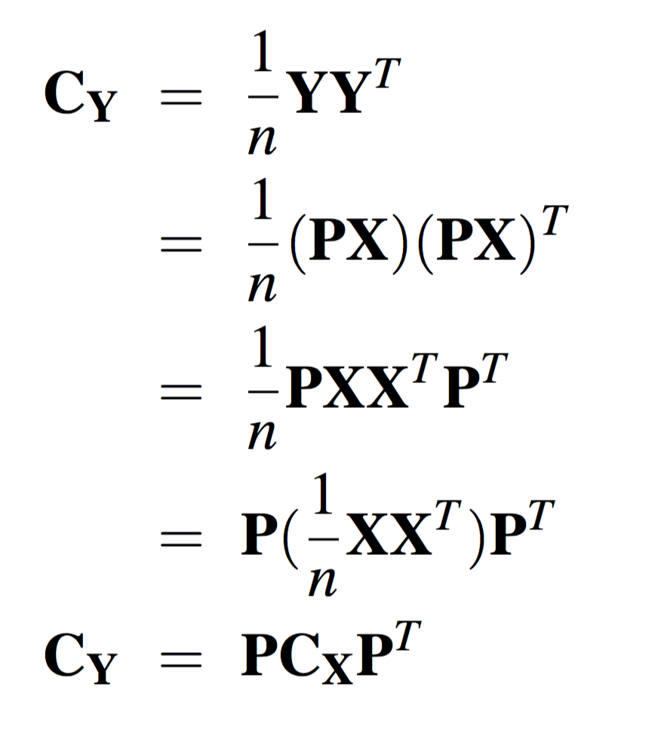
YES!
[ Presented on blackboard. More details : page 3 of A Tutorial on Principal Component Analysis (Jonathon Shlens) ]

Slide 14
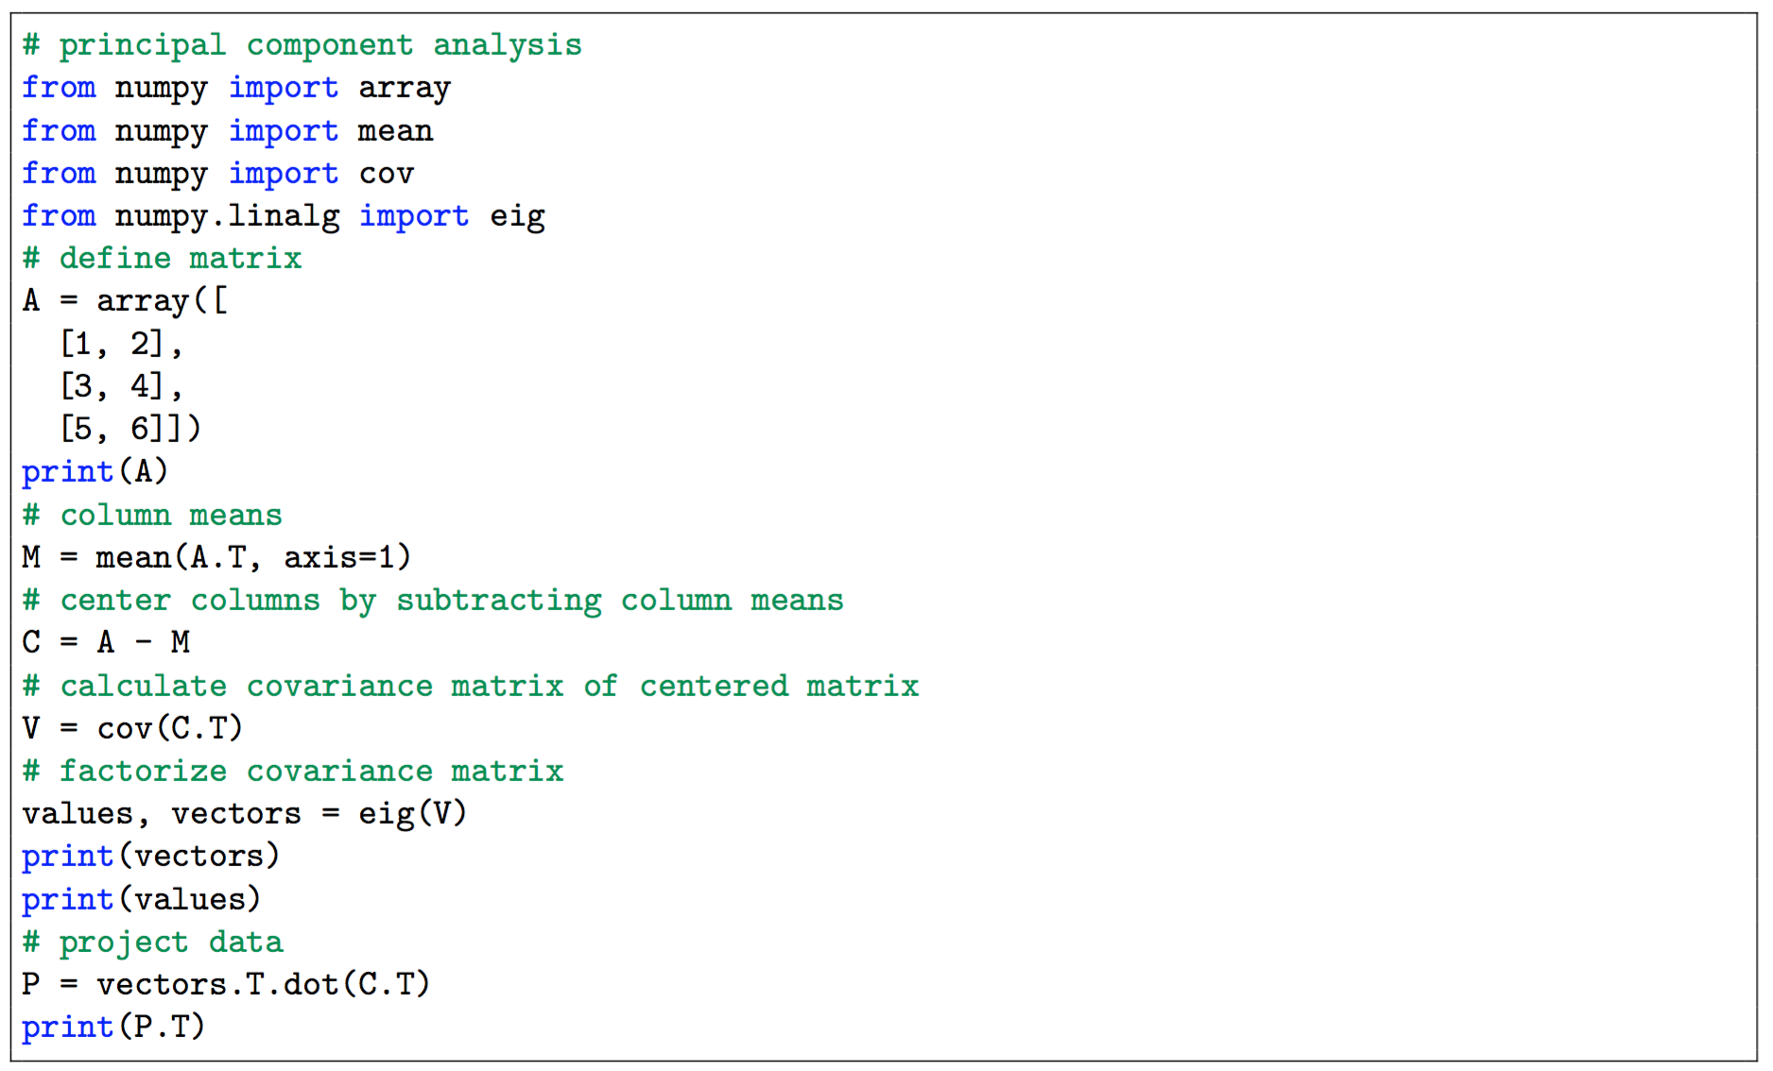
PCA in Python (numpy only)

Slide 15
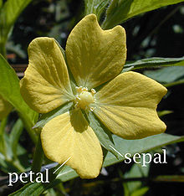
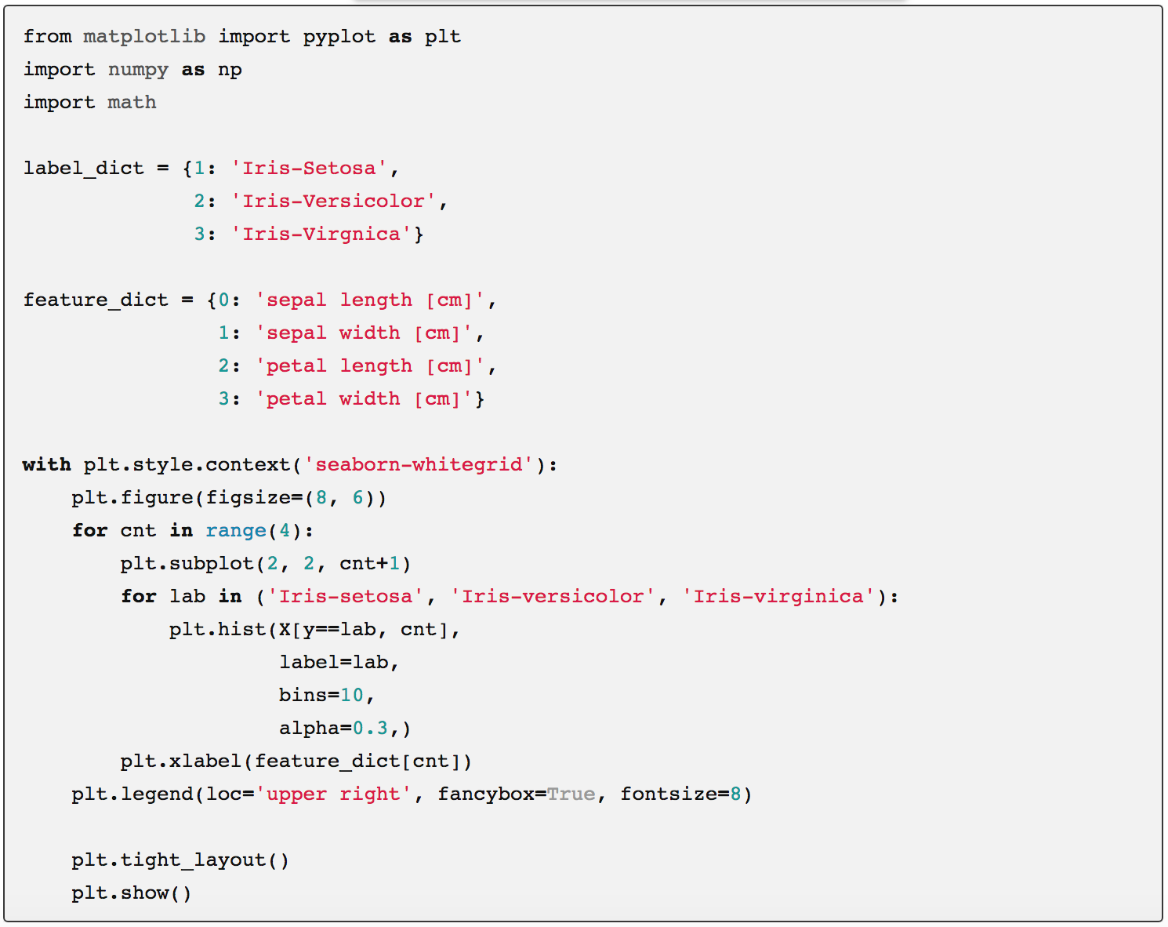
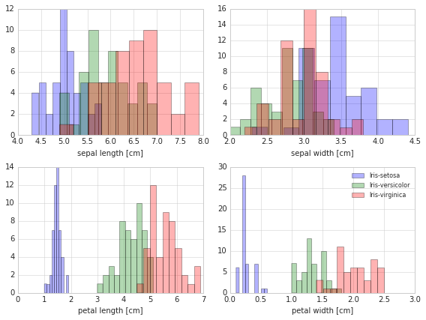
Iris Dataset - Exploratory Visualization ( https://en.wikipedia.org/wiki/Iris_flower_data_set ) https://sebastianraschka.com/Articles/2015_pca_in_3_steps.html
The three classes in the Iris dataset are:
Iris-setosa (n=50), blue
Iris-versicolor (n=50), green
Iris-virginica (n=50), red

Slide 16
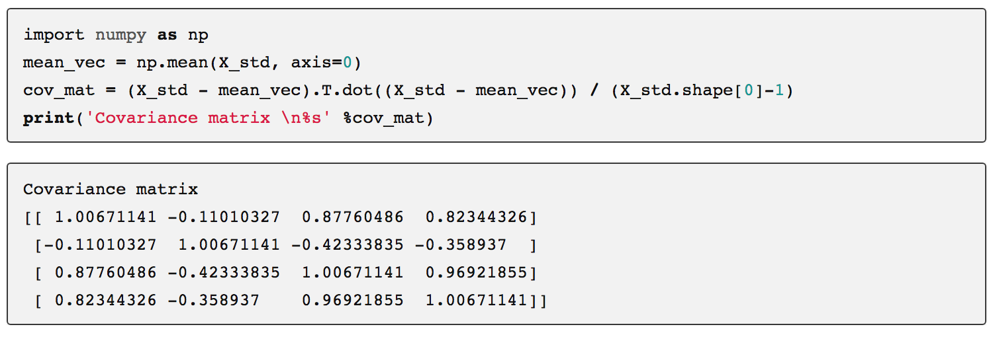
Standardizing:
Since PCA yields a feature subspace that maximizes the variance along the axes, it makes (often) sense to standardize the data, especially, if it was measured on different scales. -> mean 0, variance 1
Covariance Matrix:
Diagonal not 1? -> Bessel

Slide 17
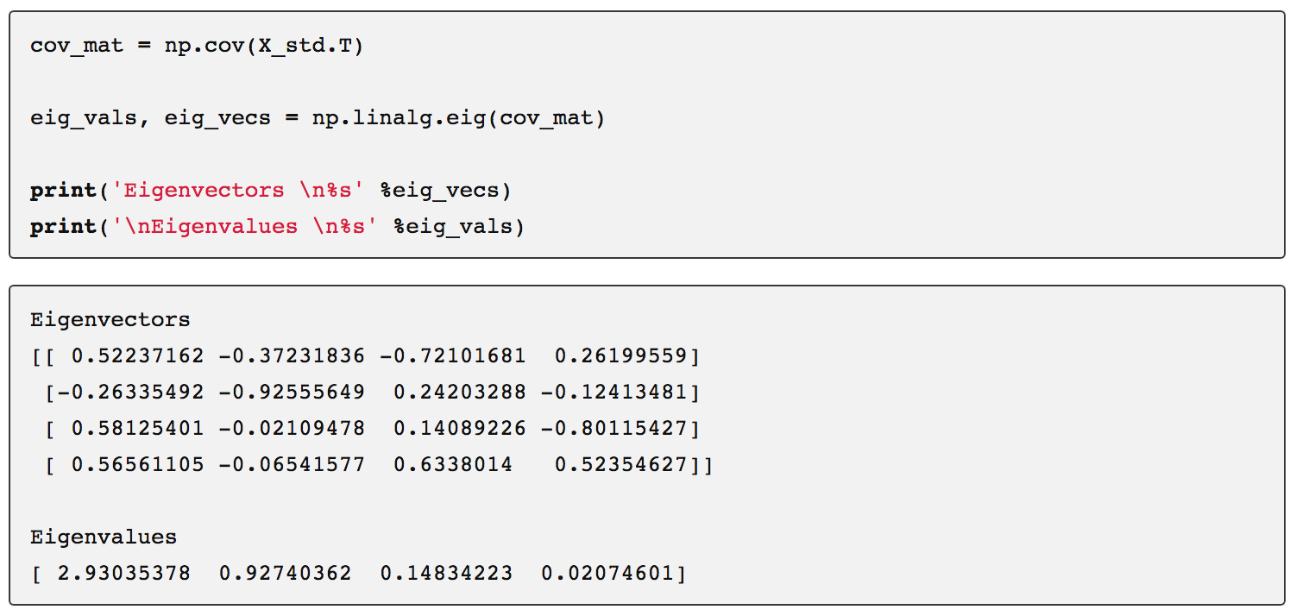
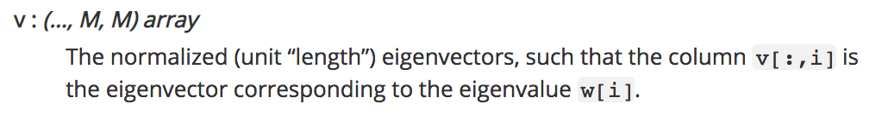
Eigenvectors (the Principal Components, see matrix P of the transformation)
Another note of caution:

Slide 18
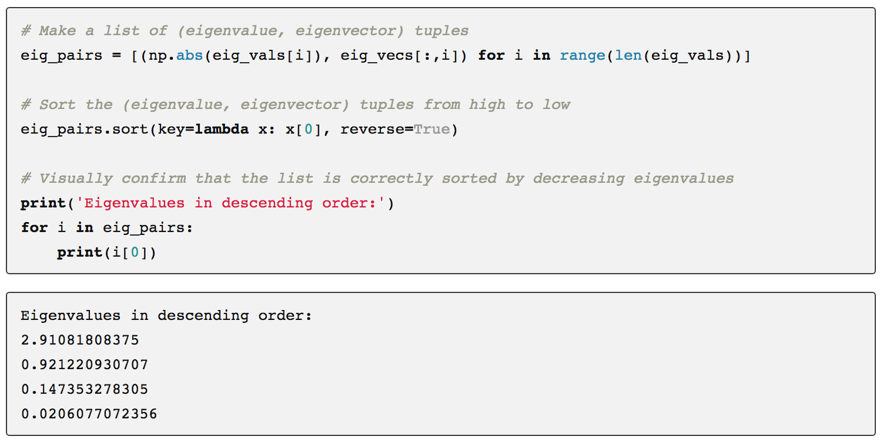
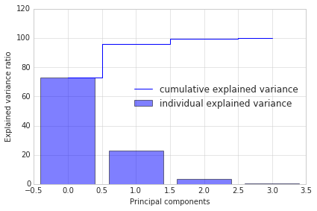
Sorting Eigenvectors
Explained variance in dataset:The first two principal components contain 95.8% of the information.

Slide 19
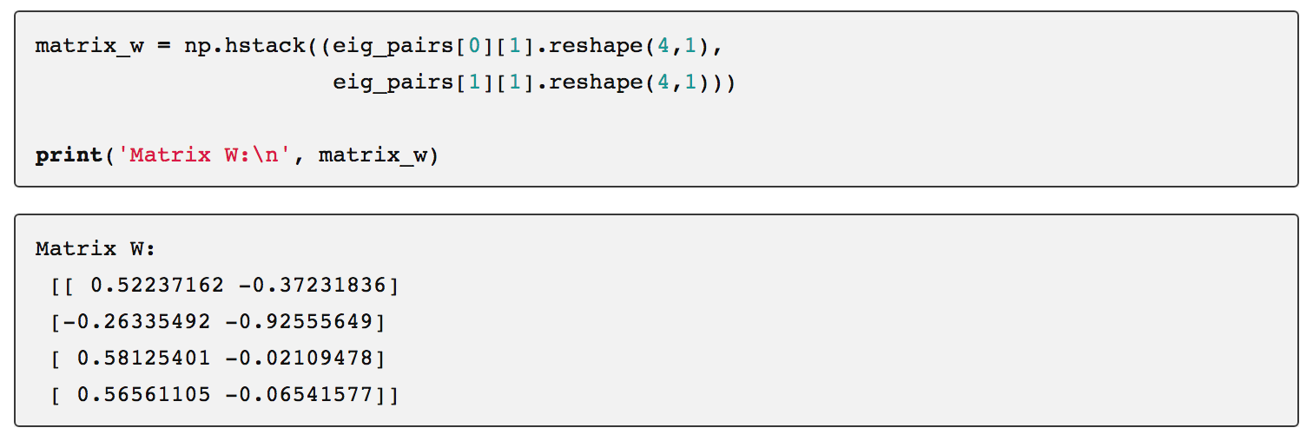
Projection onto the new feature space
Here, we are reducing the 4-dimensional feature space to a 2-dimensional feature subspace, by choosing the “top 2” eigenvectors

Slide 20
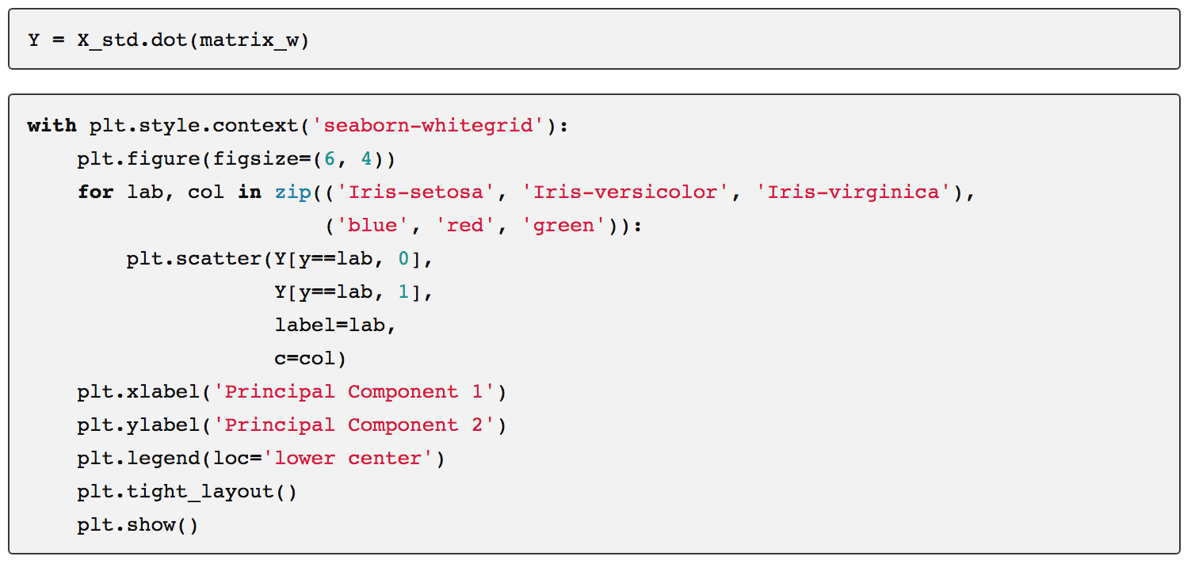
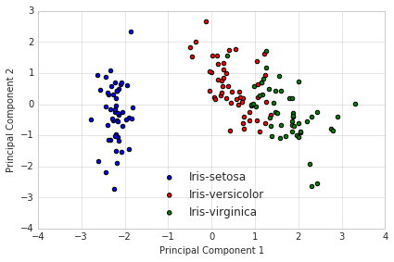
Projection onto the new feature space:

Slide 21
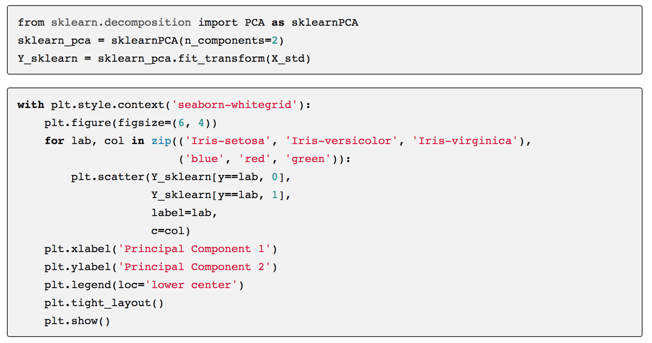
All in one go (here: sklearn)

Slide 22
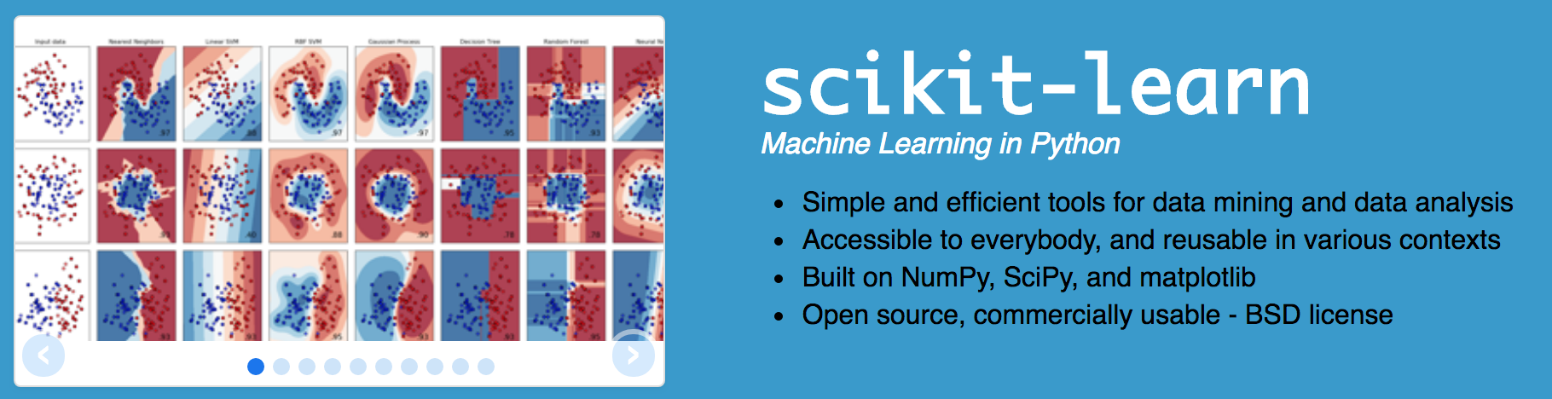
https://scikit-learn.org/

Slide 23
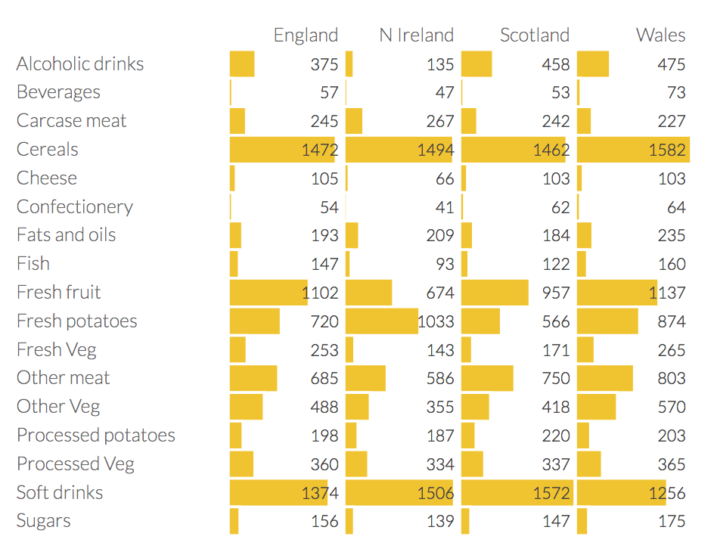
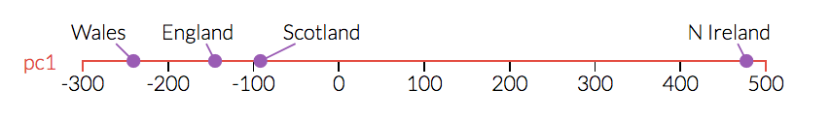
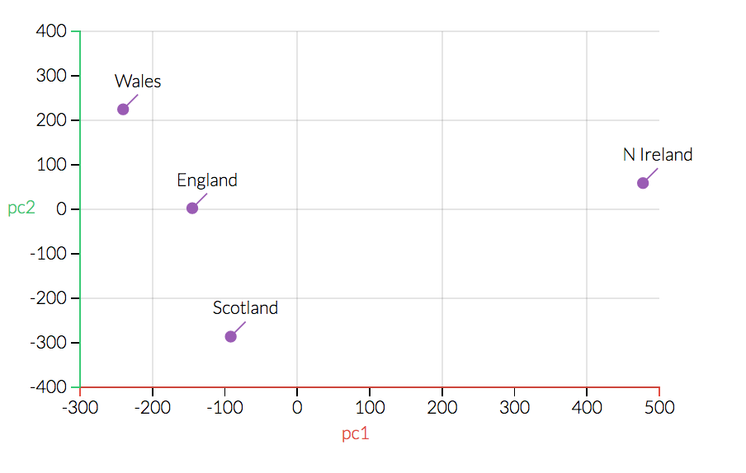
Eating in the UK (a 17d example)
1d and 2d Score Plot:
Northern Irish eat way more grams of fresh potatoes and way fewer of fresh fruits, cheese, fish and alcoholic drinks.

Slide 24

PCA on pictures. Let’s start with 64x64 dimensions.
Obtain images
Represent every image as vector
Compute the average face
Subtract the average face
Compute the covariance matrix
Use a SVD decomposition / computation of eigenvectors
Project picture into eigenface-space and measure distance
We will use OpenCV (via Python bindings) OpenCV (Open Source Computer Vision Library) is an open source computer vision and machine learning software library. https://opencv.org/

Slide 25
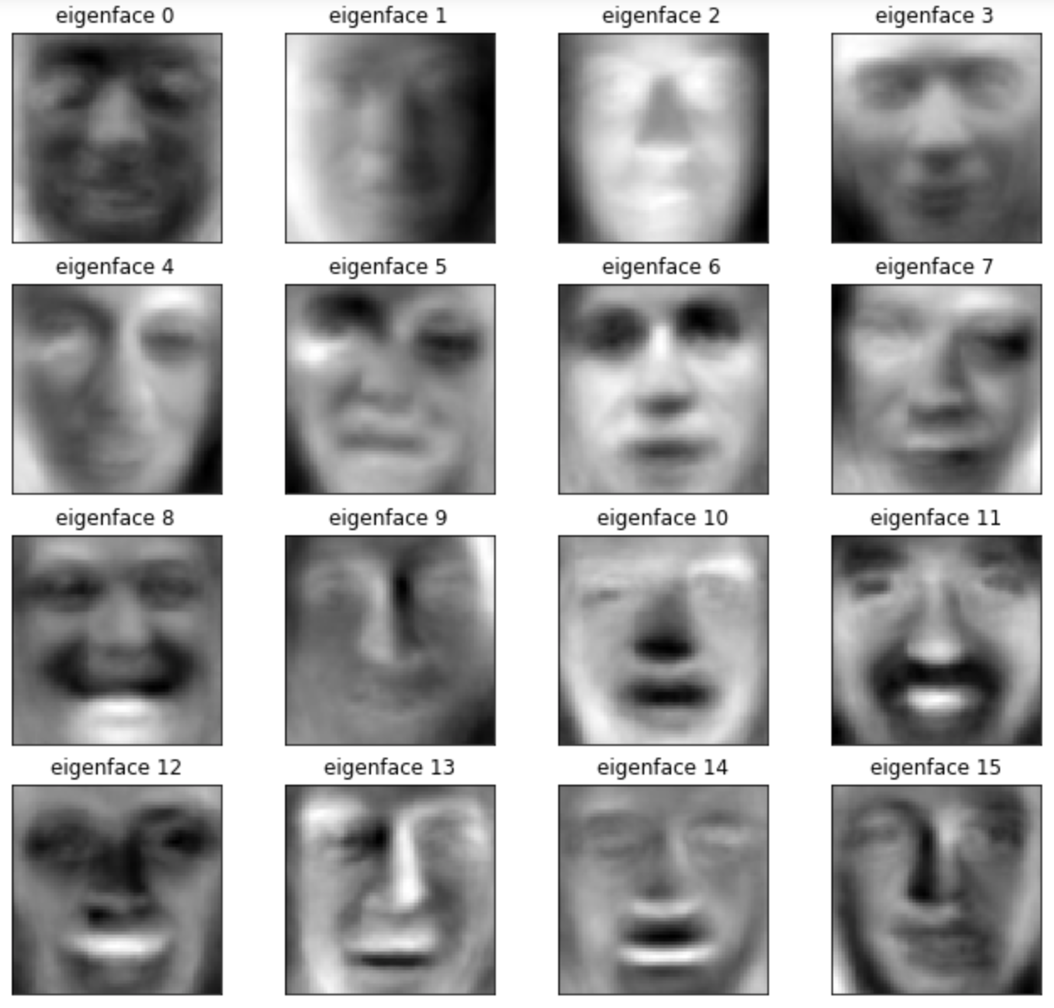
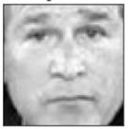
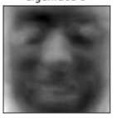
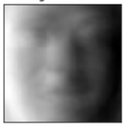
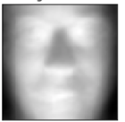
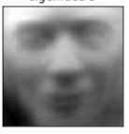
Eigenfaces (eigenvectors / principal components, visualized)
= 0.3845* -0.5435* +0.0345* -0.74645* +…

Slide 26
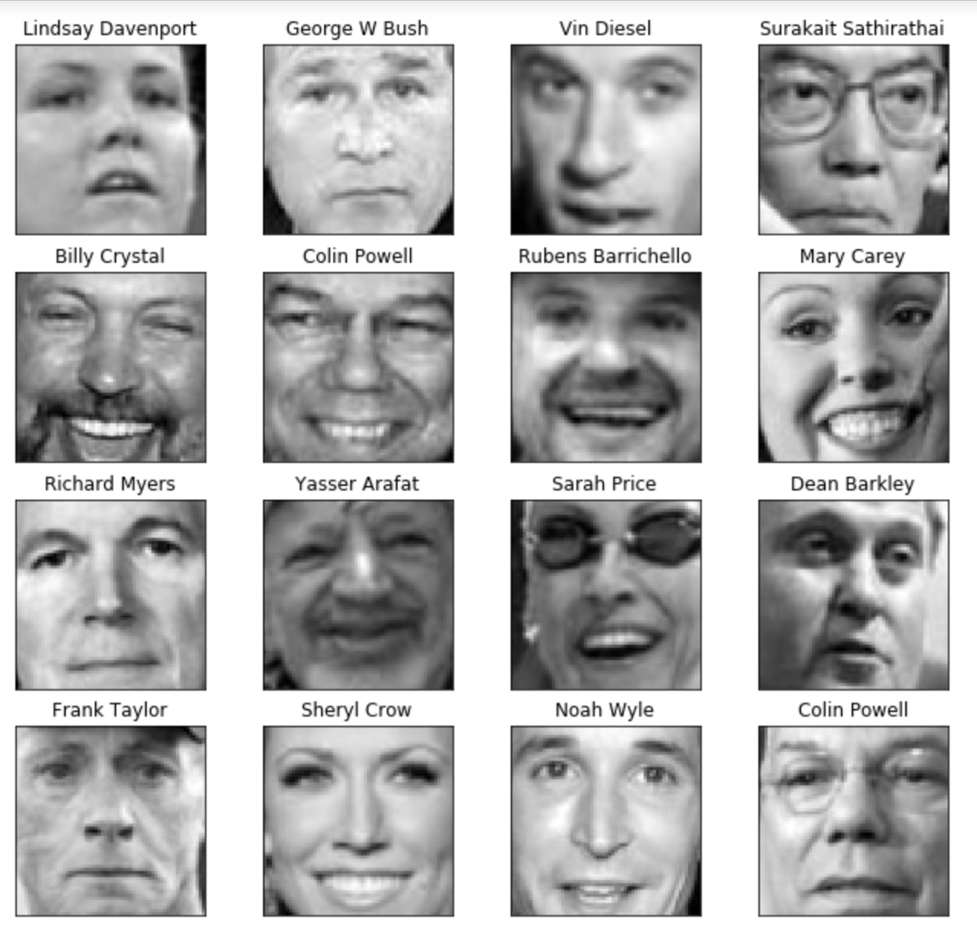
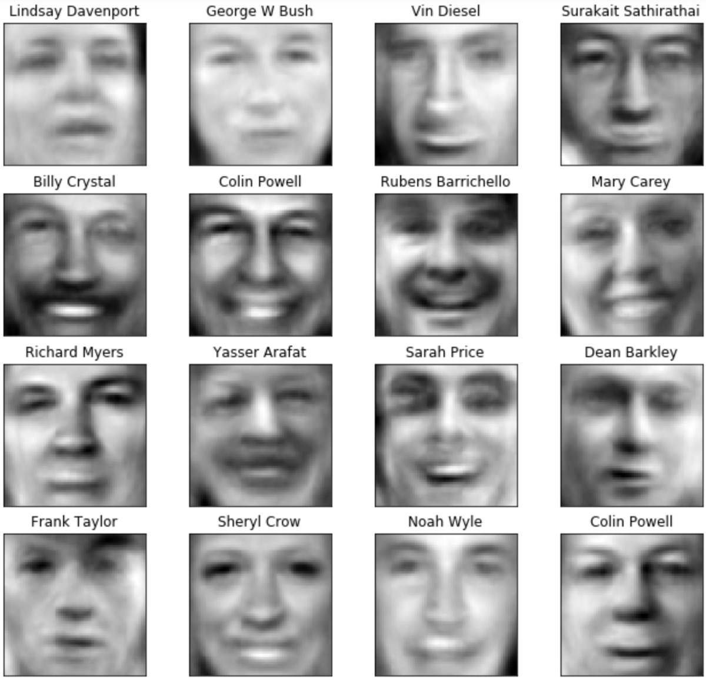
Using n=50 principal components
Original Weighted combination of n eigenfaces

Slide 27
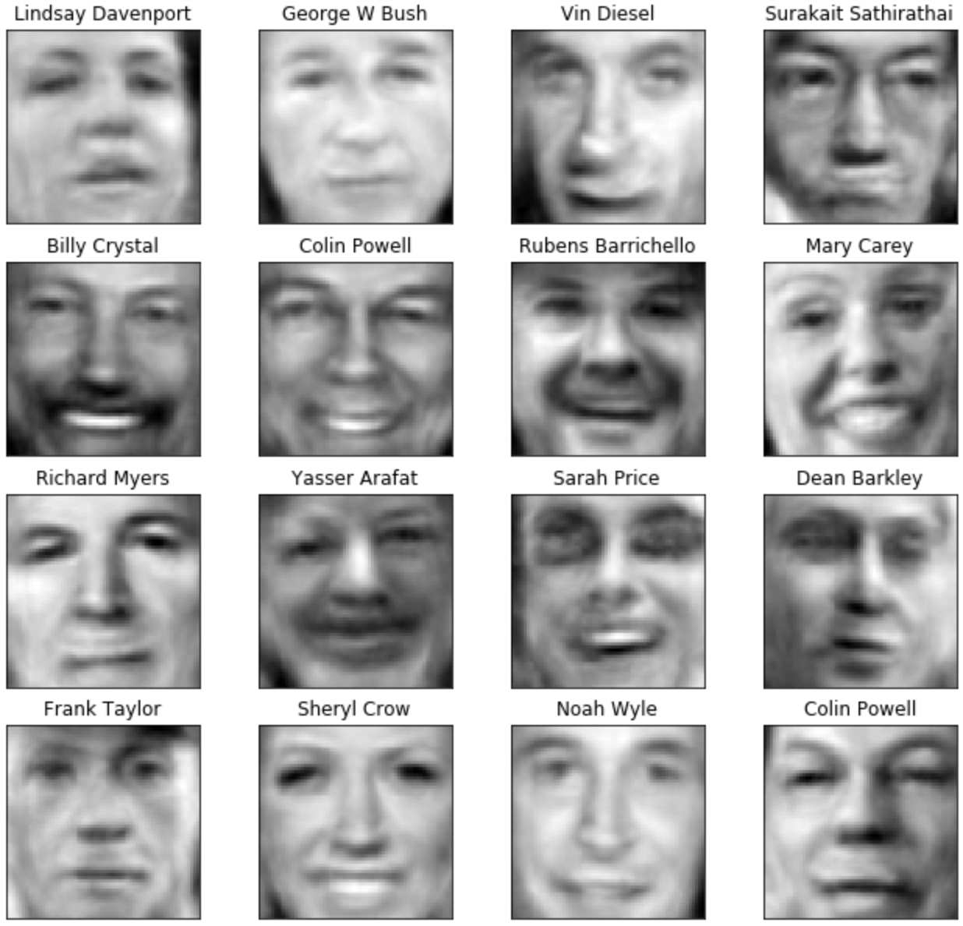
Using n=100 principal components
Original Weighted combination of n eigenfaces

Slide 28
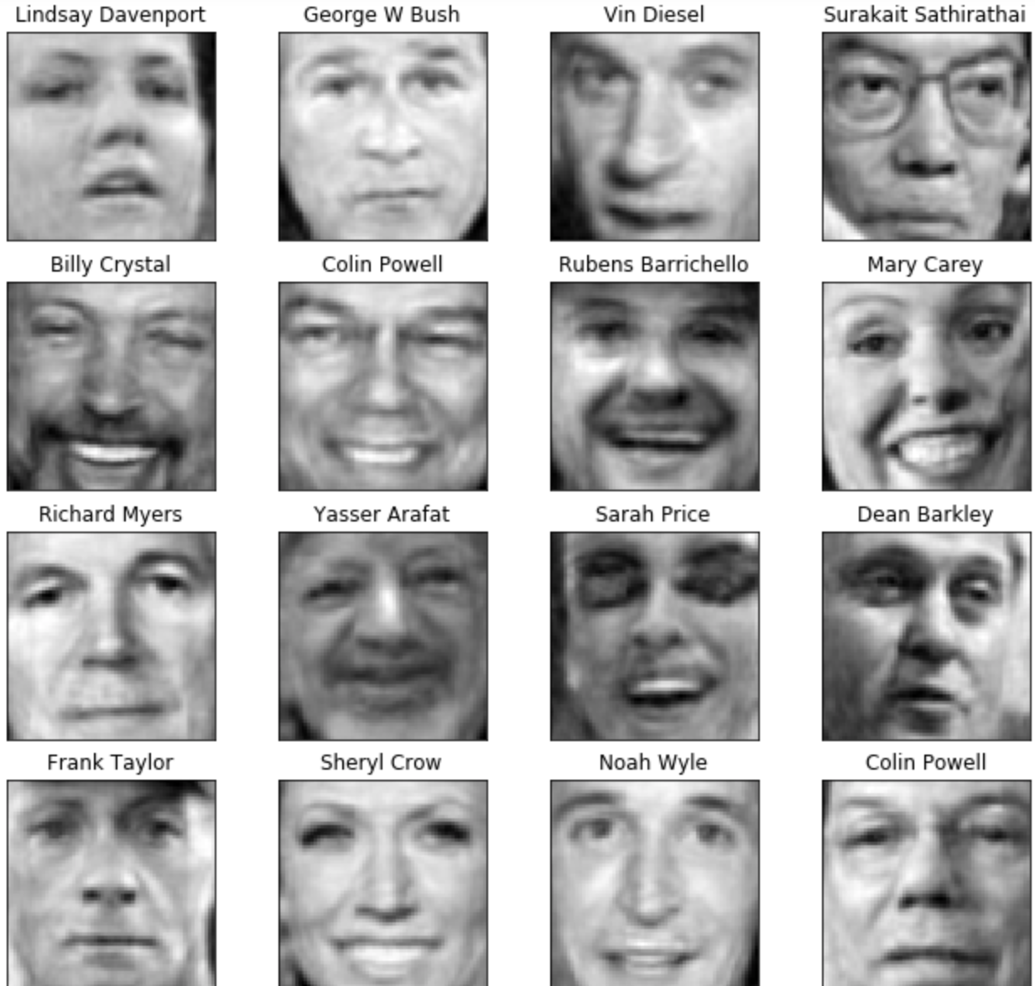
Using n=250 principal components
Original Weighted combination of n eigenfaces

Slide 29
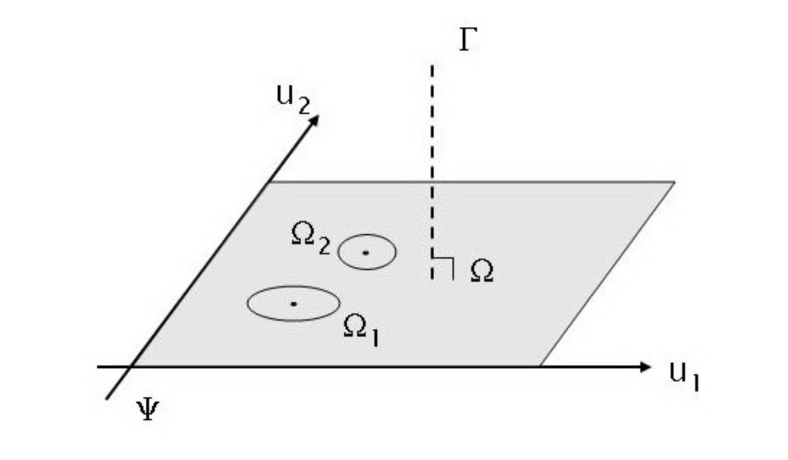
Eigenface space: origin is the average face, and axes are the eigenfaces.

Slide 30
Projection onto eigenface space.
…and using the distance to the eigenface space for classification

Slide 31
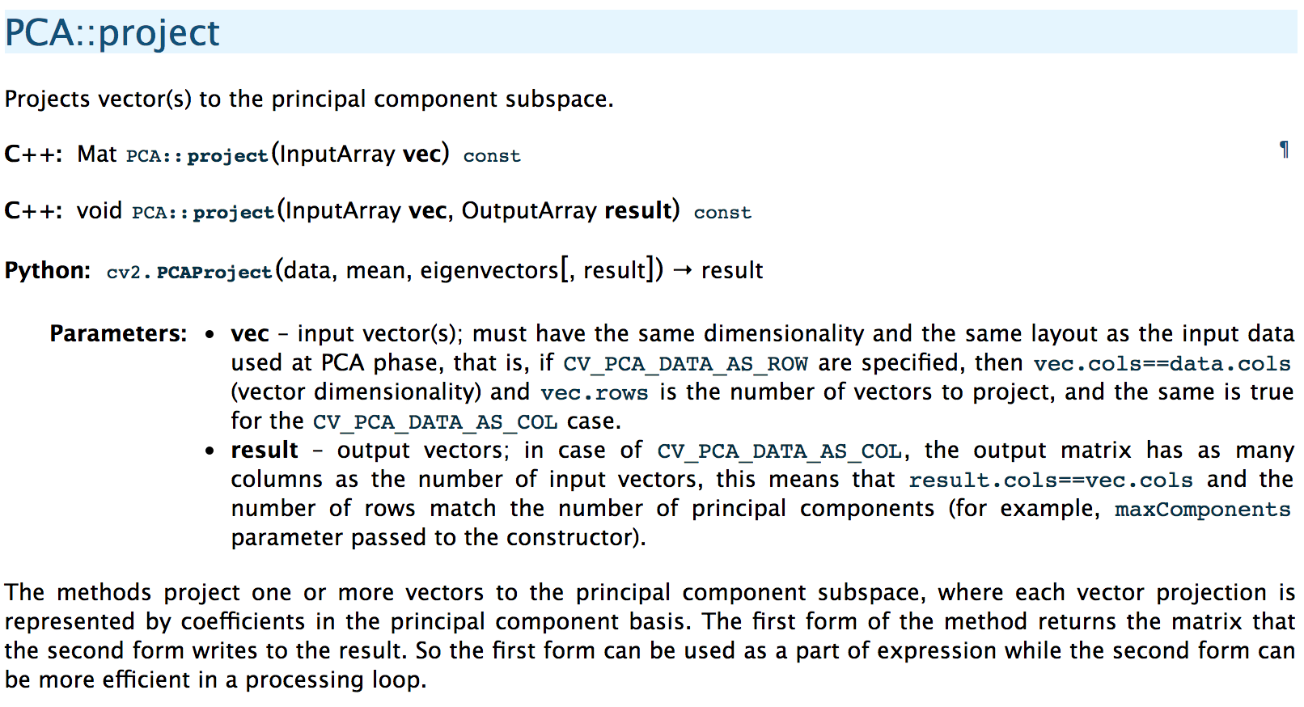

Slide 32
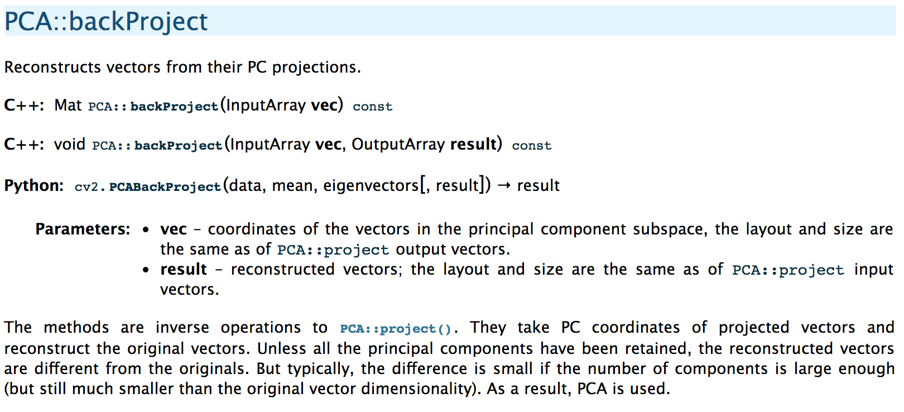

Slide 33
Example, using a 10 dimensional eigenface space:
Note: each picture is represented with 10, instead of 96768 numbers (but of course there is quality loss)
Back projection:

Slide 34
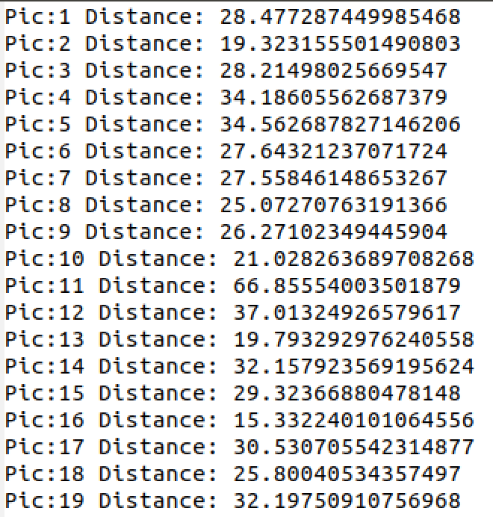
Online Demonstration based on https://www.learnopencv.com/eigenface-using-opencv-c-python/
Here: Using the square root of the sum of squared absolute distances (10-dimensional eigenface space).
Which was the dog?

Slide 35
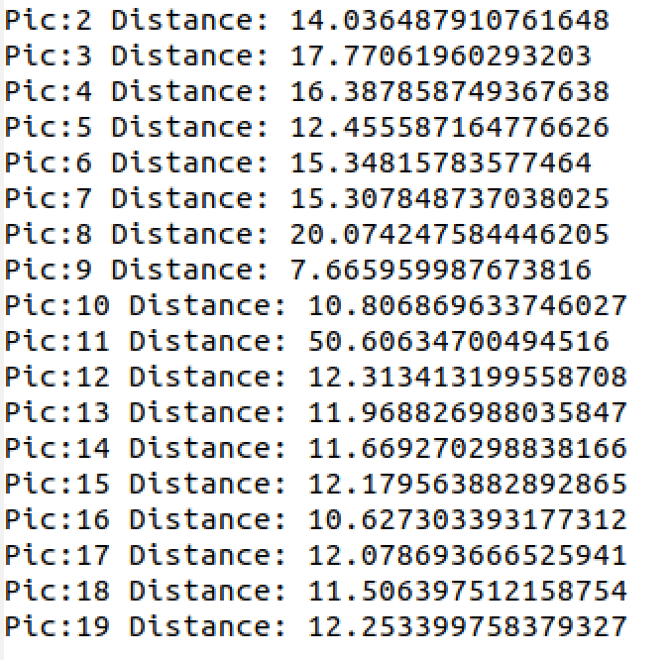
Online Demonstration
Here: 100-dimensional eigenface space.
Which was the dog?

Slide 36
Conclusion
PCA: a very important statistical procedure (some might say machine learning method) for dimensionality reduction.
Revealing the internal structure of the data in a way that best explains the variance in the data.
Used in (as such or as a basis for) a whole range of application scenarios, such as stock market predictions, the analysis of gene expression data, neuroscience, chemical compound analysis, and many many more.
Visual Intro: http://setosa.io/ev/principal-component-analysis/
A Pyhton based PCA tutorial (sklearn): https://sebastianraschka.com/Articles/2015_pca_in_3_steps.html
Eigenfaces with OpenCV: https://www.learnopencv.com/eigenface-using-opencv-c-python/

